Slide 1
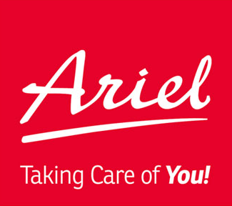
Hands-On Experience Overview
Alan Chen
Personal Introduction
Work Experience
Purdue University - Computer Engineering
Notes:
Hi everyone, I’m Alan. I’m currently studying Computer Engineering at Purdue University. Today, I’d like to share some of my academic and professional experiences with you.

Slide 2
Personal Introduction
Relevant Coursework:
Python for Data Science
Deep Learning
Technical Skills:
Programming Languages: C, C++, Python
Tools & Platforms: Linux, GitHub
Methodologies: Agile Development, Test-Driven Development
Personal Attributes:
Positive and open-minded attitude
Thrive in team environments, leveraging interpersonal strengths
Notes:
I’ve taken courses such as Python for Data Science and Deep Learning.
I am familiar with C++ and Python. I’ve worked on Linux, used GitHub, and practiced Agile and Test-Driven Development methods.
As for personal qualities, I enjoy working in teams and I’m good at building positive relationships with others.

Slide 3
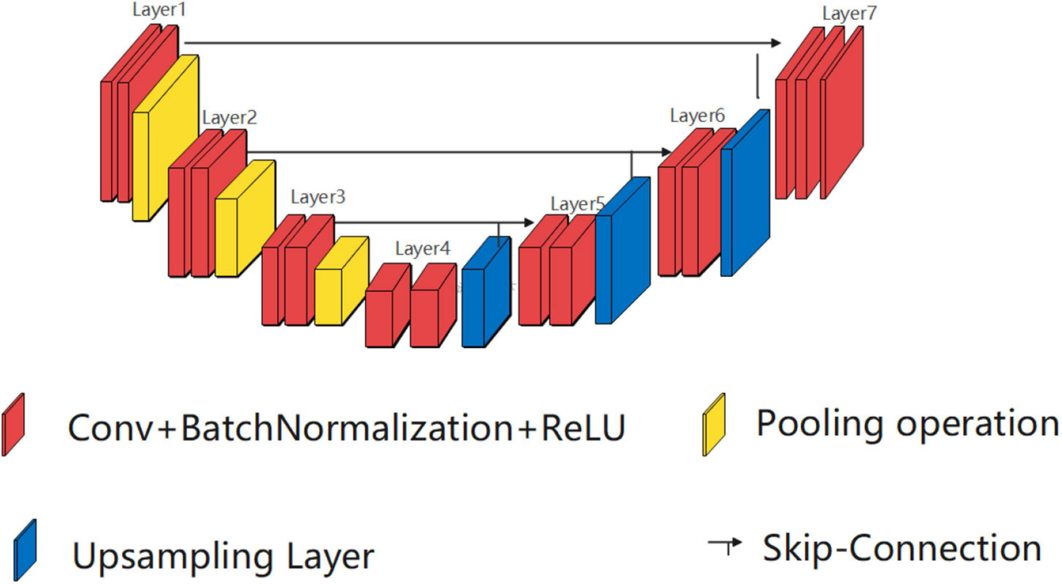
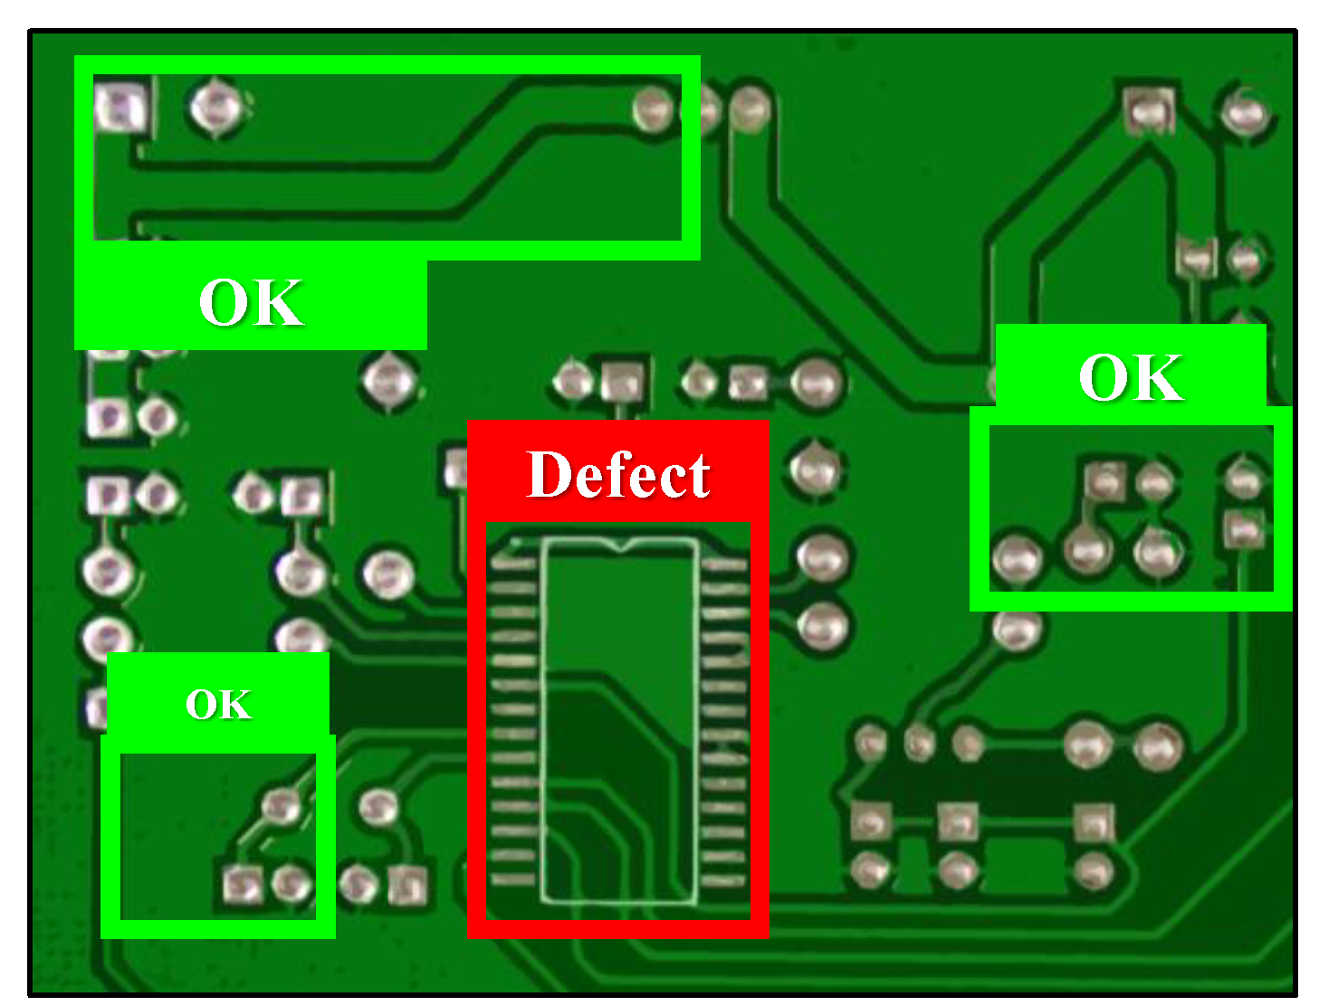
Work Experience (1)
Pegatron Corporation
Artificial Intelligence Software Engineer Intern
Deployed UNet model & Vision Prompt Segmentation model for defect detection.
Reduced undetected defects by 5%
Built an AI Model Comparison Tool
UNet
Notes:
I interned as an AI Software Engineer at Pegatron, a sub si di ary of ASUS. The factory mainly produces consumer electronic, and I was responsible for building a defect detection system for the production line.
I trained a UNet segmentation model and helped deploy a Visual Prompt Segmentation model with the team to improve inspection accuracy.
These technologies helped reduce undetected defects by 5%.
I also helped create an AI Model Comparison Tool, a web-based platform that helps users easily compare and select the best AI models. This helps workers understand model performance and switch between them when needed.

Slide 4
Visual Prompt AI for Defect Detection
Impact I can bring to Ariel Premium Supply
Quick solution for defect detection
Handles wide product variety
 | Traditional Method (UNet) | Visual Prompt Method (SegGPT)
Data Requirement | Requires large, labeled datasets for each product | 👑 No need for large labeled datasets; uses visual prompts
Accuracy | 👑 Higher accuracy for specific tasks | Lower accuracy for specific tasks
Flexibility | Limited to specific product types it was trained for | 👑 Highly flexible; can be applied to a wide variety of products
Cost Effectiveness | Expensive due to dataset labeling and training requirements | 👑 Cost-effective due to reduced need for labeled data and retraining
Notes:
Here’s how I can help Ariel Premium Supply.
I can offer a quick defect detection solution. I understand that your company produces a wide variety of products, and you may not have a large labeled dataset for defects.
Traditional deep learning models require lots of labeled data, and they need to be retrained for each product. Without seeing a product before, the model may not recognize defects.
But with Visual Prompt models, we can deploy them quickly without collecting large datasets. Even with new products, the model can still identify defects right away.
All in all, the visual prompt model is more flexible and might be a better fit for Ariel

Slide 5
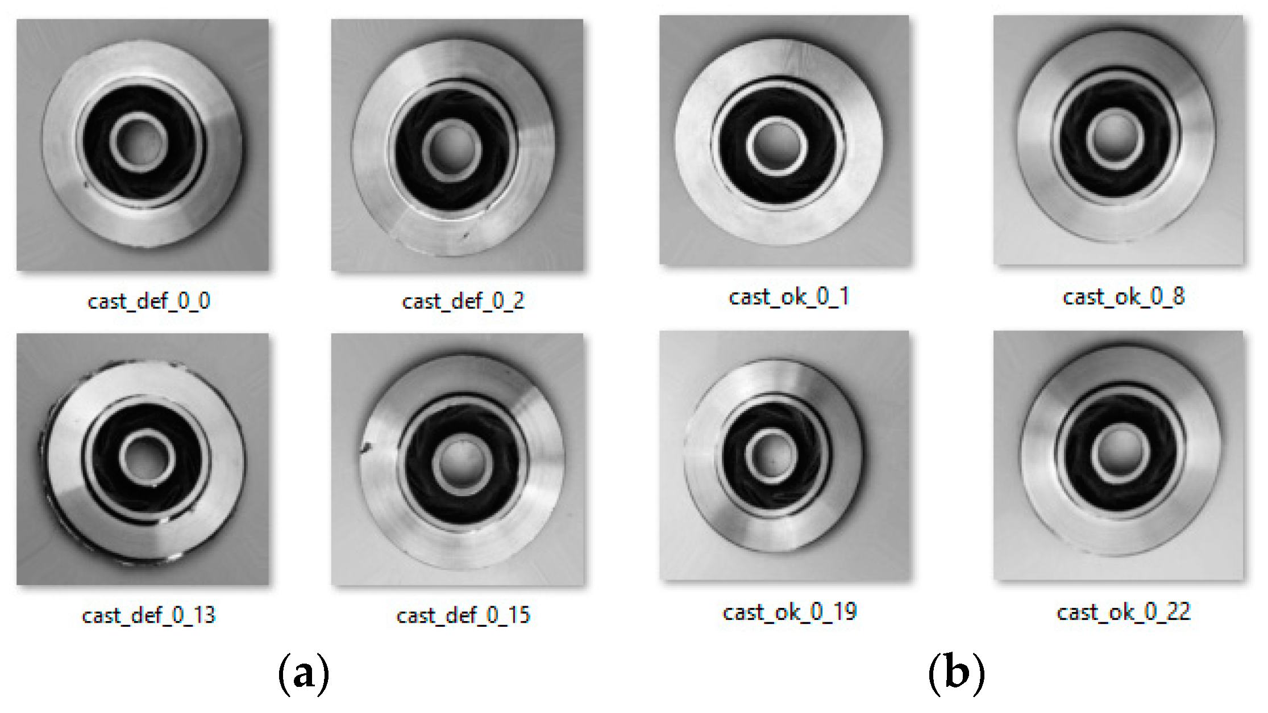
Visual Prompt AI for Defect Detection
Example
Visual Prompt Input
DINO-X Platform | Unleashing the Power of Cutting-Edge Computer Vision Technology
Notes:
Let me give an example. This is a car brake disc, and you can see there's a defect here.
The goal is to mark the defect, so the model can learn what defect looks like.

Slide 6
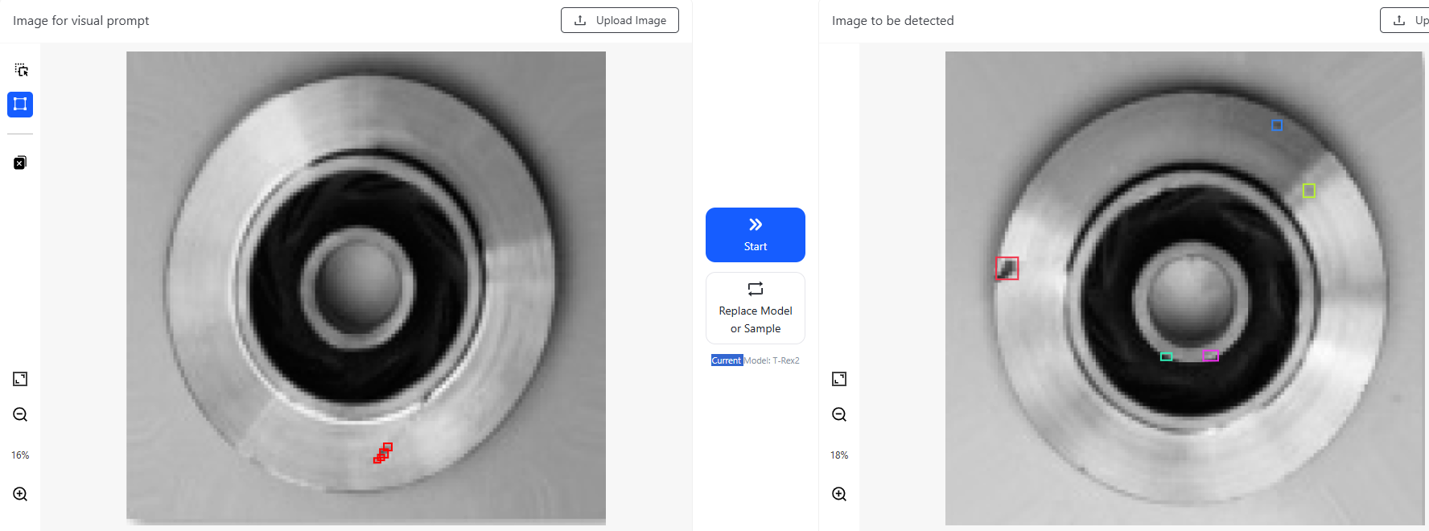
Visual Prompt AI for Defect Detection
Example
Visual Prompt Input Labeled Visual Prompt Input
DINO-X Platform | Unleashing the Power of Cutting-Edge Computer Vision Technology
Notes:
On the right side, you see the labeled image, with the defect highlighted in red.
We use this image as a visual prompt to show the model what we want it to focus on.

Slide 7

Visual Prompt AI for Defect Detection
Example
Model Input
Model
DINO-X Platform | Unleashing the Power of Cutting-Edge Computer Vision Technology
Notes:
Here’s another image of a car brake disc, also with a defect.
We feed this new image into the model that just received the visual prompt, and see how it performs.

Slide 8
Visual Prompt AI for Defect Detection
Example
Model Input Model Output
DINO-X Platform | Unleashing the Power of Cutting-Edge Computer Vision Technology
Notes:
As you can see, the model detected the defect, but it also made some mistakes.
While Visual Prompt models are fast to deploy and flexible, their accuracy may not be as high as specially trained models.
There’s a trade-off between speed and precision. We can adjust this balance depending on Ariel’s needs.
If you’re interested, I’d be happy to share more details about my work at Pegatron.

Slide 9


Work Experience (2)
Sky Lab – Corporate Research Lab (Purdue & UW–Madison)
Fine-tuned LLMs for WisDOT
Improved project planning via WisTMP
Real-world collaboration with state agencies
Supports generation of Transportation Management Plans
Notes:
I’m also working at Sky Lab, a joint research lab between Purdue and the University of Wisconsin–Madison.
My current project is about fine-tuning large language models (LLMs) to help the Wisconsin Department of Transportation (WisDOT) use the TMP system.
The goal is to assist government workers in creating Transportation Management Plans, and improve project planning.

Slide 10

LLＭ Integration for Factory Intelligence
Impact I can bring to Ariel Premium Supply
Build LLM-powered customer service assistant
Enable workers to access real-time production line data using natural language queries.
Improve communication, efficiency, and decision-making on the factory floor
Notes:
Based on my experience with LLMs, I see a few ways to help Ariel:
First, we can develop an LLM-based customer service assistant to handle questions, track orders, and answer FAQs. This can improve response time and reduce staff workload.
Second, we can use LLMs internally, so factory workers or managers can ask natural questions like “How is production line 3 doing?” or “How many units did we make today?” without checking dashboards or reports.
This will improve real-time decision-making and make systems easier to use.

Slide 11
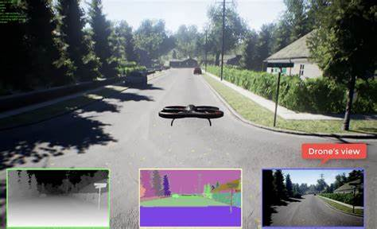
Work Experience (3)
Senior Design Project – Autonomous Drone
Project Leader
Trained autonomous drone in Microsoft AirSim
Applied Deep Reinforcement Learning
Focused on indoor search & rescue
Strengthened skills in team leadership
Notes:
As for leadership, I was the team leader of our senior design project. We trained an autonomous drone using deep reinforcement learning, and used Microsoft AirSim to simulate indoor search and rescue.
This video shows the drone, controlled by an AI model, searching in a simulated environment.
As a leader, I set small goals for each phase and made sure everyone in the team contributed. Through this experience, I learned to lead by using agile method to keep the team moving forward.

Slide 12
Hands-On Experience Overview
Alan Chen
Personal Introduction
Work Experience
Purdue University - Computer Engineering
Notes:
My Question:
"Can you share how defects are currently detected in your production line?"
"What are the most common challenges your team faces in quality control or product inspection?“
"Are there existing AI or automation tools used in your workflow right now?"
May I ask what majors the other interns are from, and what kind of projects they will be working on?
I’m wondering about the company lodging. I’m a little worried about the condition—do you have any photos or more details about the place?
I’m wondering — if the internship only lasts for one month, would it end before I have a chance to achieve any meaningful results?
By the way, I noticed my wage seems to be quite below average—do interns usually get reviewed or adjusted based on their experience or project scope?

